Slide 1
Entity Framework Core
Working with Stored Procedures, and Raw SQL

Slide 2
Lesson Objectives
Shadow Property
Execute Raw SQL Queries
Executing Stored Procedures in EF Core
View Executing a Raw SQL (Optional)

Slide 3
Shadow Property
Section 1

Slide 4
Shadow Property in EF Core
EF Core introduced a new type of property called "Shadow" property which was not exist in EF 6.x.
Shadow properties are the properties that are not defined in .NET entity class
Shadow properties allow you to “hide” data that you consider not to be part of the normal use of the entity class
Can be included in the model and are mapped to database columns
we can have columns for these properties in our tables, but we will not have a corresponding property field in our entity class.
The value and state of these properties are maintained purely in the ChangeTracker.
These are useful when there is data in the database that should not be exposed to the mapped entity types.

Slide 5
Shadow Property in EF Core
Shadow properties are useful in many scenarios:
Can be used for extending a model where not have access to the source code of the entity classes.
Can also be used in cases where we prefer that the class definitions of out entities don't include "relational artifacts" such as:
foreign key columns
or metadata properties like DateCreated or LastUpdated, or a rowversion property.

Slide 6
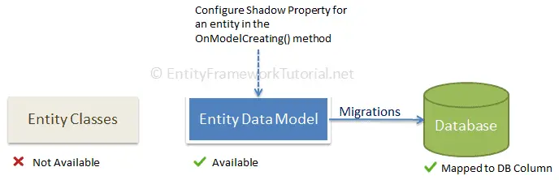
Shadow Property in EF Core
can be configured in the OnModelCreating() method of the context class

Slide 7
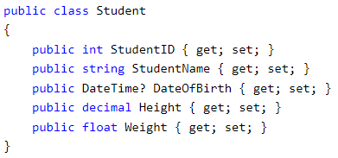
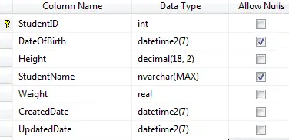
Shadow Property
For example: The Student entity class does not include CreatedDate and
UpdatedDate properties to maintain created or updated time
Assume that we need to maintain the created and updated date of each record in the database table → using shadow properties without including them in entity classes.
?

Slide 8
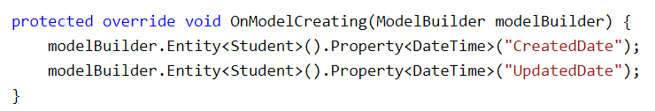
Defining Shadow Property
Define the shadow properties for an entity type using the Fluent API in the OnModelCreating() using the Property() method
Syntax:
modelBuilder.Entity<EntityType>()
.Property<PropertyType>("PropertyName");
Ex:

Slide 9
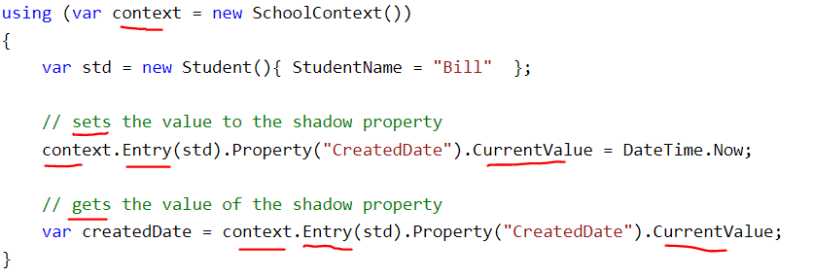
Access Shadow Properties (1)
Can an access of the shadow properties using the Property method of Entity Entry.
And get or set the values via the CurrentValue property

Slide 10
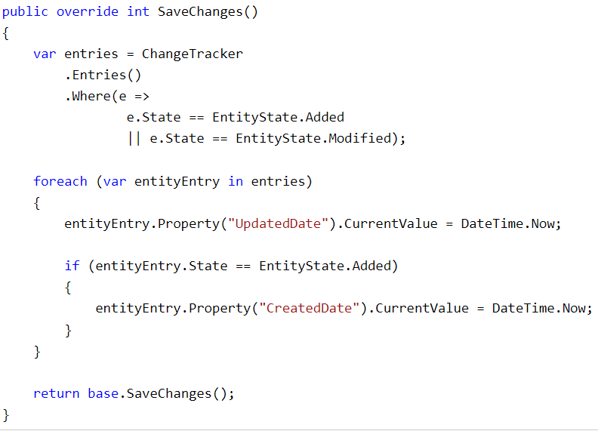
Access Shadow Properties (2)
Can also set values via the ChangeTracker API through its Entries() method.
This offers a more logical way to set a LastUpdated value by overriding the SaveChanges method

Slide 11
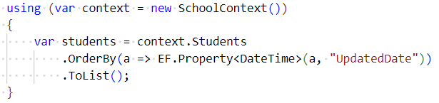
Access Shadow Properties (3)
Can reference shadow properties in LINQ queries via the static Property method of the EF utility class
can't access shadow properties after a no-tracking query since the entities returned are not tracked by the change tracker.

Slide 12
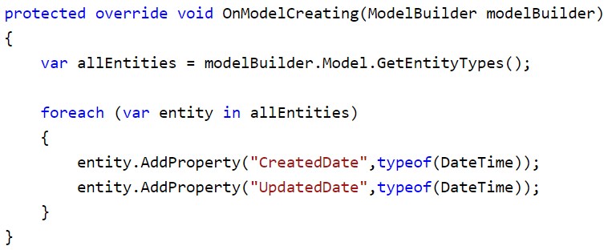
Configuring Shadow Properties on All Entities
can configure shadow properties on all entities at once, rather than configuring them manually for all
Ex: we can configure CreatedDate and UpdatedDate on all the entities at once

Slide 13
Execute Raw SQL Queries
Section 2
Notes:
Execute Raw SQL Queries

Slide 14
EF Core Raw SQL Query
EF Core also provides mechanisms for executing raw SQL queries directly against the database in circumstances where you can not use LINQ to represent the query (e.g. a Full-Text Search),
if the generated SQL is not efficient enough, if you want to make use of existing stored procedures, or if you just prefer to write your queries in SQL.

Slide 15
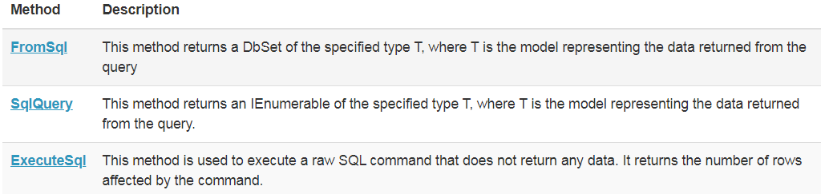
Several ways SQL Query in EF Core
Can execute raw SQL queries in several ways:
. EF Core 6 use FromSqlInterpolated instead
Notes:
EF Core 6 use FromSqlInterpolated instead

Slide 16
Raw SQL Query - Limitations
When returning entity types from SQL queries, you must be aware of all the limitations:
Your SQL query must return all the properties of the entity type.
The column names in the result set must match the column names that properties are mapped to.
The SQL query can't contain related data. However, in many cases, you can compose on top of the query using the Include operator to return related data.

Slide 17
FromSqlInterpolated/FromSql

Slide 18
Raw SQL Query - FromSqlInterpolated
The FromSqlInterpolated /FromSql method in EF Core allows you to execute a raw SQL query and map the results to entities.
It's used to retrieve data from a database using custom SQL and map it directly to a type that represents the data.

Slide 19
FromSqlInterpolated/FromSql
The FromSqlInterpolated / FromSql method is an extension method on the DbSet class and takes a raw SQL query string and an array of parameters as arguments.
The results of the query are then materialized into entity objects and returned as an IQueryable which can be further manipulated or enumerated.
The FromSql was introduced in EF Core 7.0, if you are using older versions of EF Core, make sure to use FromSqlInterpolated instead.

Slide 20
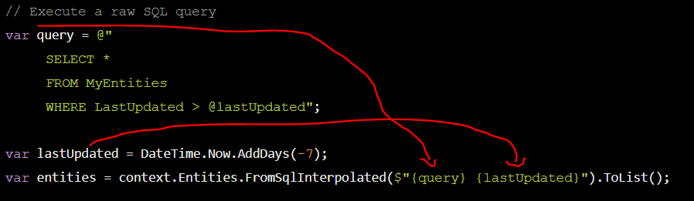
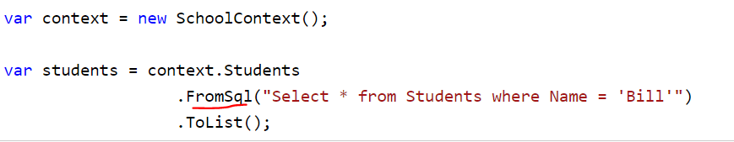
Raw SQL Query
FromSqlInterpolated
Ex:
FromSql

Slide 21
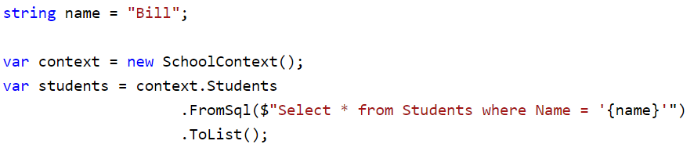
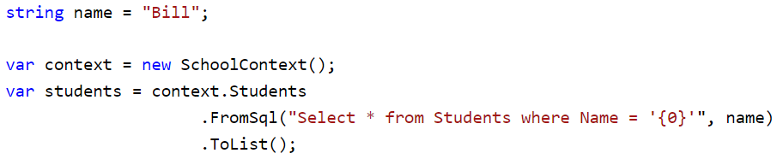
Execute Raw SQL Queries
Parameterized Query: allows parameterized queries using string interpolation syntax in C#
Or

Slide 22
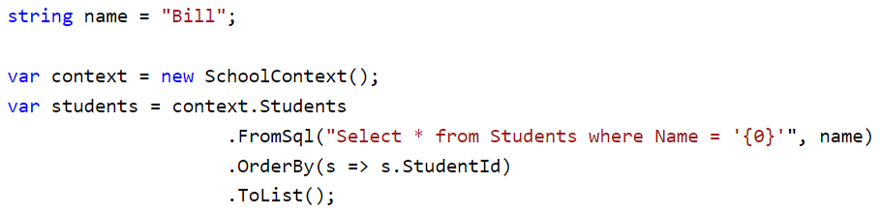
Execute Raw SQL Queries
LINQ Operators: use LINQ Operators after a raw query using FromSql method.

Slide 23
EF Core SqlQuery

Slide 24
EF Core SqlQuery
Querying scalar types involves using LINQ to query the data in the database and retrieve the scalar values as result.
Scalar values are single values such as integers, strings, or dates, as opposed to complex types.
To query scalar types, can use the Select operator in LINQ to select the specific scalar values that you want to retrieve, and then call ToList() or FirstOrDefault() on the query to execute it and retrieve the results.

Slide 25
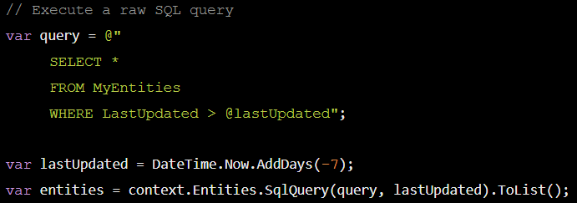
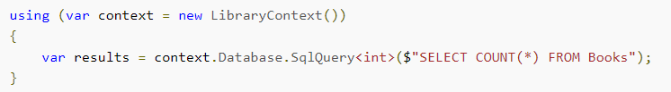
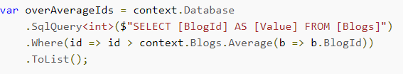
EF Core SqlQuery
Example 1
Example 2
Compose LINQ operators over SQL query

Slide 26
EF Core SqlQuery
when using the SqlQuery method to return scalar or non-entity types,
it's important to ensure that the query returns a result set that corresponds to the specified generic type.
If the result set does not match the type, an exception will be thrown.

Slide 27
EF Core ExecuteSql

Slide 28
EF Core ExecuteSql (1)
The DbContext exposes a Database property which includes a method called ExecuteSql.
This method returns an integer specifying the number of rows affected by the SQL statement passed to it.
Valid operations are INSERT, UPDATE, and DELETE.
The method is not used for returning entities.

Slide 29
EF Core ExecuteSql (2)
Allows to execute raw SQL statements directly against the database.
This method can be useful when need to perform database operations that are not supported by the LINQ to Entities API, or when you want to perform database-specific operations.
ExecuteSql protects against SQL injection by using safe parameterization

Slide 30
EF Core ExecuteSql (3)
Before EF Core 7.0, it was sometimes necessary to use the ExecuteSql APIs to perform a "bulk update" on the database,
EF Core 7.0 introduced ExecuteUpdate and ExecuteDelete, which made it possible to express efficient bulk update operations via LINQ.

Slide 31
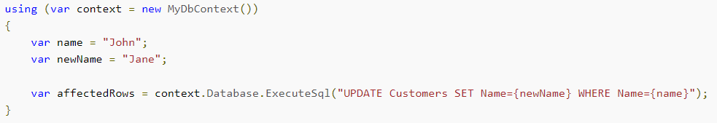
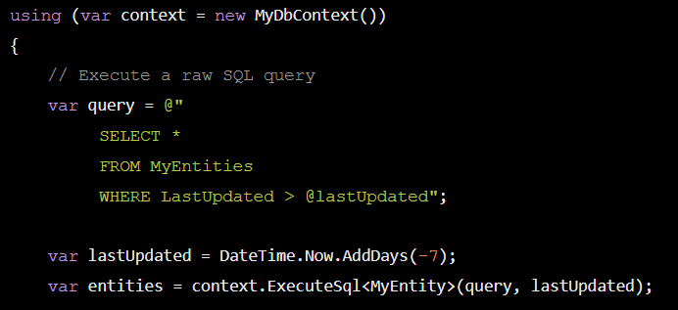
EF Core ExecuteSql - Example
Example 1
Example 2

Slide 32
Executing Stored Procedures
Section 3

Slide 33
Executing Stored Procedures
The EF Core allows you to use stored procedures to perform predefined logic on database tables.
To execute a stored procedure, you can use raw SQL queries in the following methods.
DbSet<TEntity>.FromSqlRaw()
DbContext.Database.ExecuteSqlRaw()

Slide 34
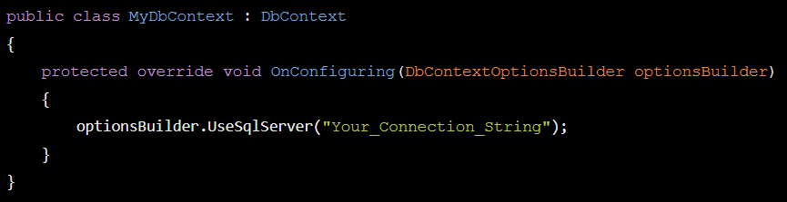
Executing Stored Procedures - Guide
The step-by-step guide on working with stored procedures in EF Core 6.
Step 1: Define the DbContext and Connection

Slide 35
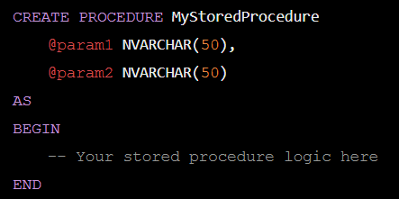
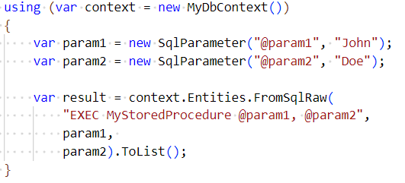
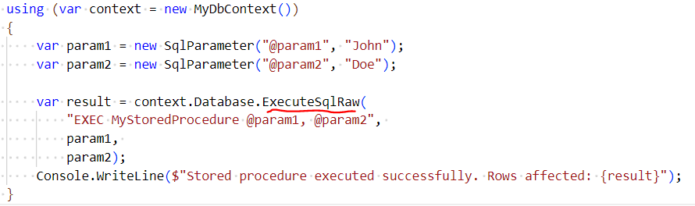
Executing Stored Procedures - Guide
Step 2: Create the Stored Procedure in your SQL Server database
Step 3: Call the Stored Procedure
Using FromSqlRaw
Using ExecuteSqlRaw

Slide 36
Limitations
The return type of a stored procedure:
Must be an entity type,
and must return all the columns of the corresponding table of an entity.
Related data must not be part of the result, and a stored procedure cannot perform JOINs to formulate the result.
The column names in the result set must match the column names that properties are mapped to.

Slide 37
Querying Data from a Database View
Section 4
https://www.csharptutorial.net/entity-framework-core-tutorial/ef-core-views/

Slide 38

Thank you

